Slide 1
CUSTOMER SEGMENTATION ANALYSIS USING POWER BI
By
Bharani Kumar G
Sai Swapna
Divyanshu Sharma
Mishty
Soundarya
Naga Charanya

Slide 2
Introduction to Power BI
Power BI, by Microsoft, is powerful business analytics tool for transforming raw data into actionable insights.
It enables interactive dashboards and visually engaging reports, enhancing decision making.
Seamlessly integrates data from multiple sources for a unified view of business metrics.
Essential for simplifying data, uncovering trends, and presenting insights effectively.

Slide 3
Data Analysis Journey
Data Collection
Data Preprocessing
Exploratory Data Analysis
Data Visualization

Slide 4
Data Collection
Source: Data collected from Kaggle - Shopping Trends dataset.
Demographic Information: Includes Customer ID, Age, and Gender.
Product & Purchase Details: Captures Item Purchased, Category, and Purchase Amount (USD).
Segmentation & Trends: Contains Location, Size, Color, Season, Review Rating, Subscription Status, Payment Method, and Behavioral trends like Previous Purchases and Purchase Frequency.

Slide 5
Data Preprocessing
PreProcessing Steps:
Remove duplicates and outliers
Standardize data formats
Create columns for calculated metrics
Dax Functions Used:
SUM & AVERAGE for aggregated metrics
CALCULATE for filtering and computing totals
RANKX for ranking customer value

Slide 6
Data Cleaning
Handling Missing Values: Replaced or removed missing data in critical columns like Age, Purchase Amount, and Review Rating.
Data Validation: Ensured accurate data types (e.g., numeric for Purchase Amount, categorical for Gender and Category).
Duplicate Removal: Eliminated duplicate entries to prevent redundancy and maintain dataset integrity.

Slide 7
Data Visualization
1
2
3
CLARITY
Complex data into visual elements
HIGHLIGHT TRENDS
Trends, outliers and patterns
ACTIONABLE INSIGHTS
Better decision-making

Slide 8
SHOPPING TRENDS AND INSIGHTS
CUSTOMER INFORMATIONS:
Captures demographics, purchase history, and customer perferences to identify behavior and segmentation opportunities.
PRODUCT DETAILS:
Provides insights into product categories, pricing, and sales trends to analyse performance and demand.
TRANSACTION DATA:
Records purchase details, including date, time and amount spent, to uncover spending patterns and seasonality.

Slide 9
KEY INSIGHTS
Loyal Customer Values
Loyal customers contribute significantly to revenue
Seasonal Trends
Seasonal trends inpact shopping behavior
Promotion Influence
Promotions and discounts influence demographics

Slide 10
FILTERS USED
CATEGORY:
Accessories, Footwear, Clothing, Outerwear
SEASONS
Fall, Summer, Spring, Winter
SIZE
Large, Medium, Small, XL
GENDER
Male, Female

Slide 11
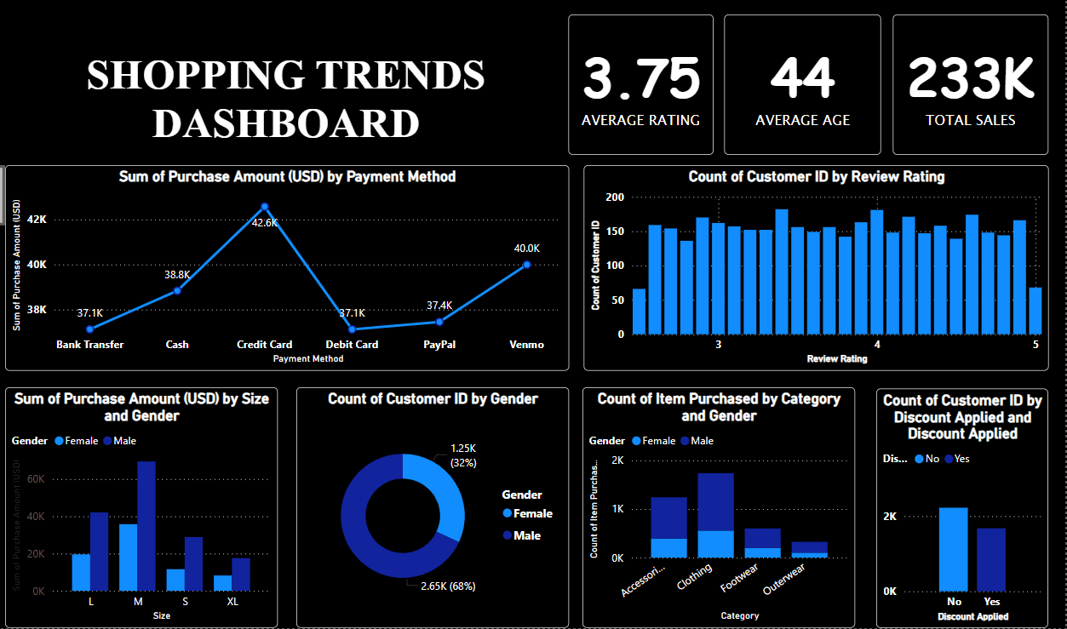

Slide 12
THANK YOU

